Slide 1
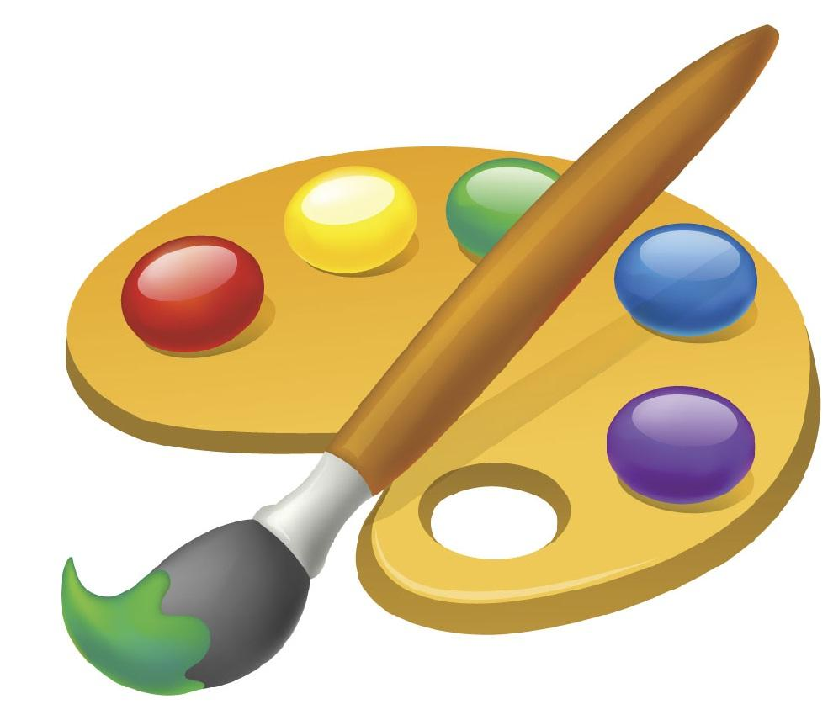
AMERICAN
ART HISTORY

Slide 2
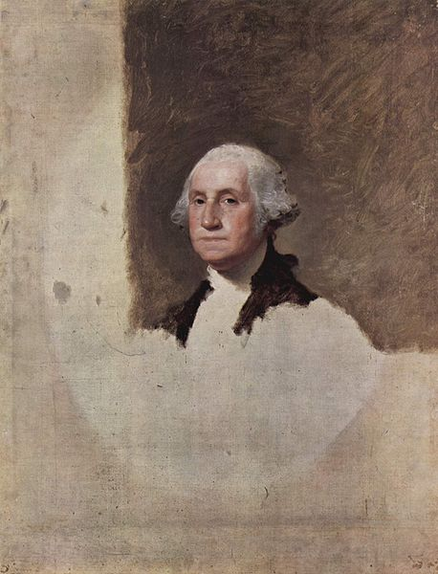
Gilbert Stuart
Gilbert Stuart (1755-1828) American painter, most famous for painting the portrait of Washington which was copied for the one dollar bill.
Washington died before the painting could be finished.

Slide 3
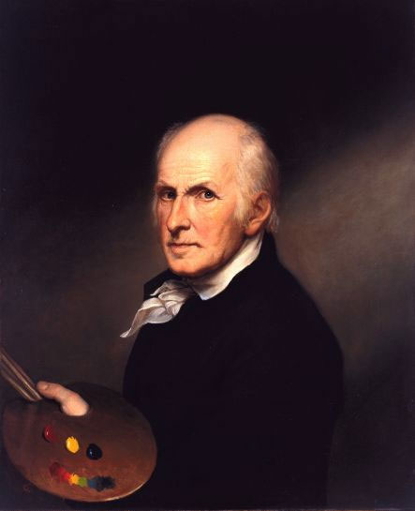
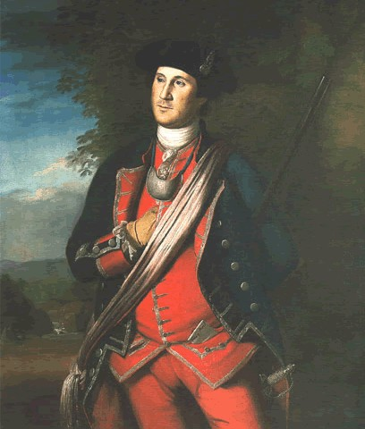
Charles Wilson Peale (1741-1827) An American naturalist painter.
Peale was an American painter, soldier and naturalist. He is best remembered for his portrait paintings of leading figures of the American Revolution, as well as for establishing one of the first museums.

Slide 4
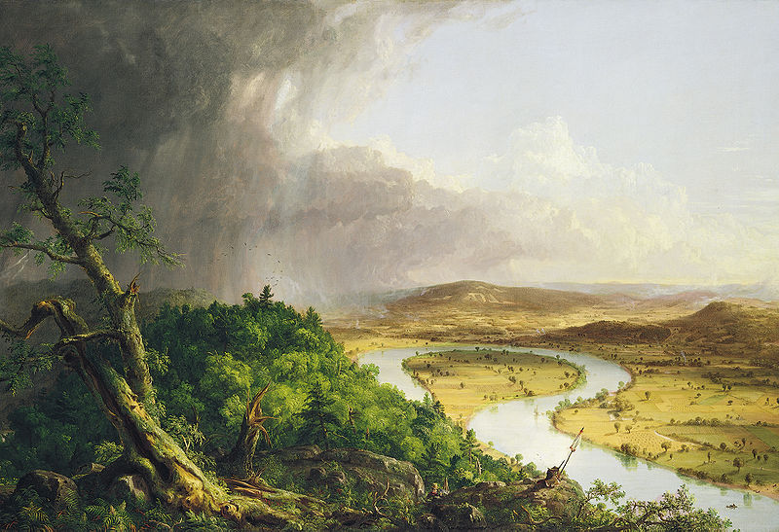
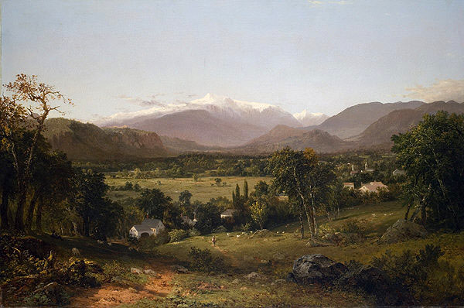
Hudson River School of Art
In about 1825, a group of American painters, led by Thomas Cole, used their talents to do landscapes, which were not highly regarded. They painted many scenes of New York's Hudson River. Mystical overtones

Slide 5
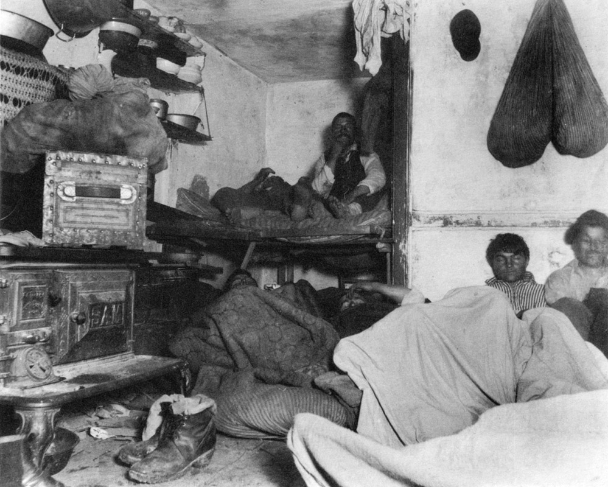
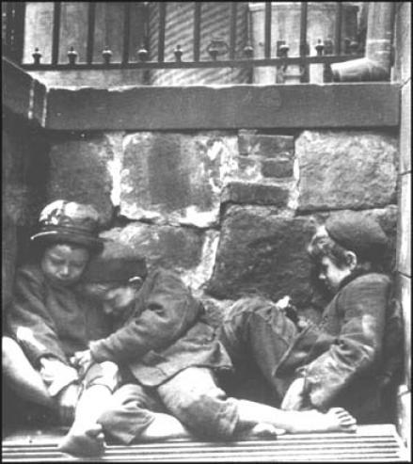
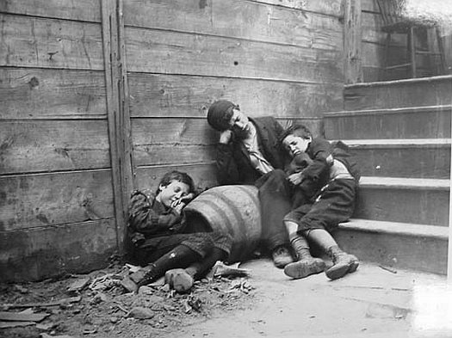
How the Other Half Lives
Jacob August Riis (May 3, 1849 - May 26, 1914), was a Danish American social reformer, muckraking journalist and social documentary photographer. In his book he documented the plight of the immigrant.

Slide 6
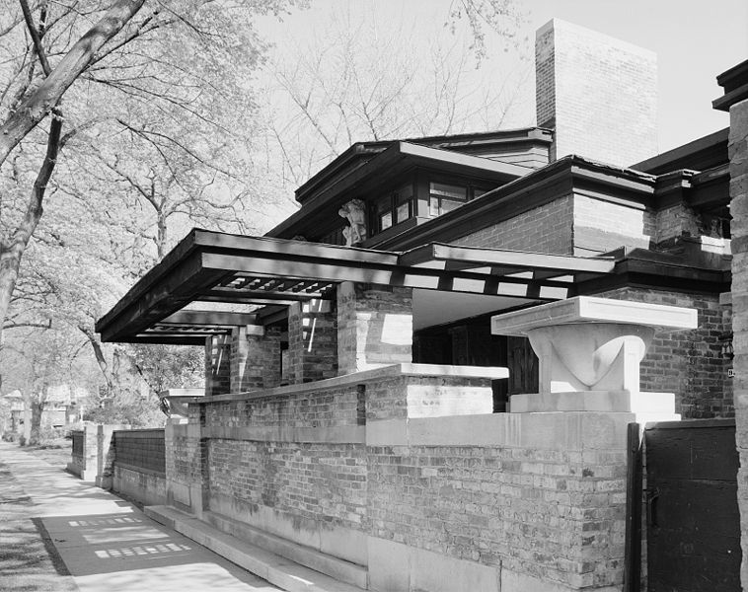
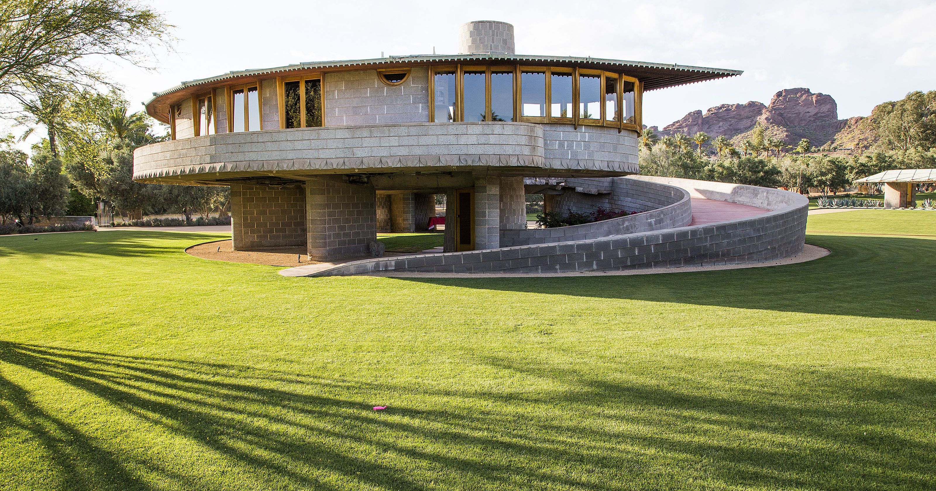
Frank Lloyd Wright Considered America's greatest architect. Pioneered the concept that a building should blend into and harmonize with its surroundings rather than following classical designs.

Slide 7
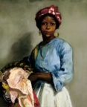
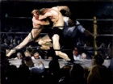
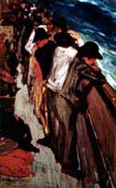
ASHCAN SCHOOL
Also known as The Eight, a group of American Naturalist painters formed in 1907, most of whom had formerly been newspaper illustrators, they believed in portraying scenes from everyday life in starkly realistic detail. Their 1908 display was the first art show in the U.S.
Stag at Sharkeys- George Bellows

Slide 8
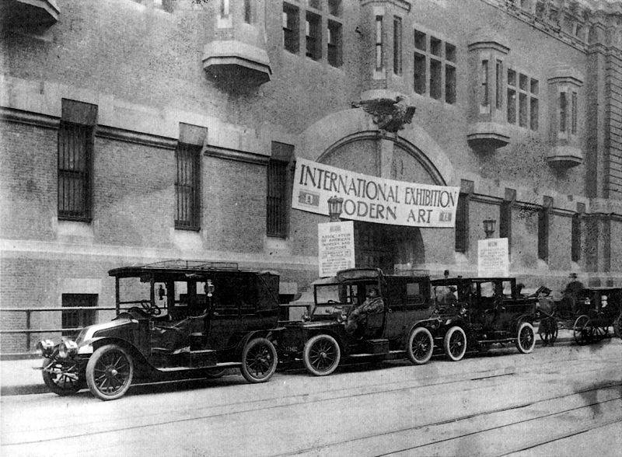
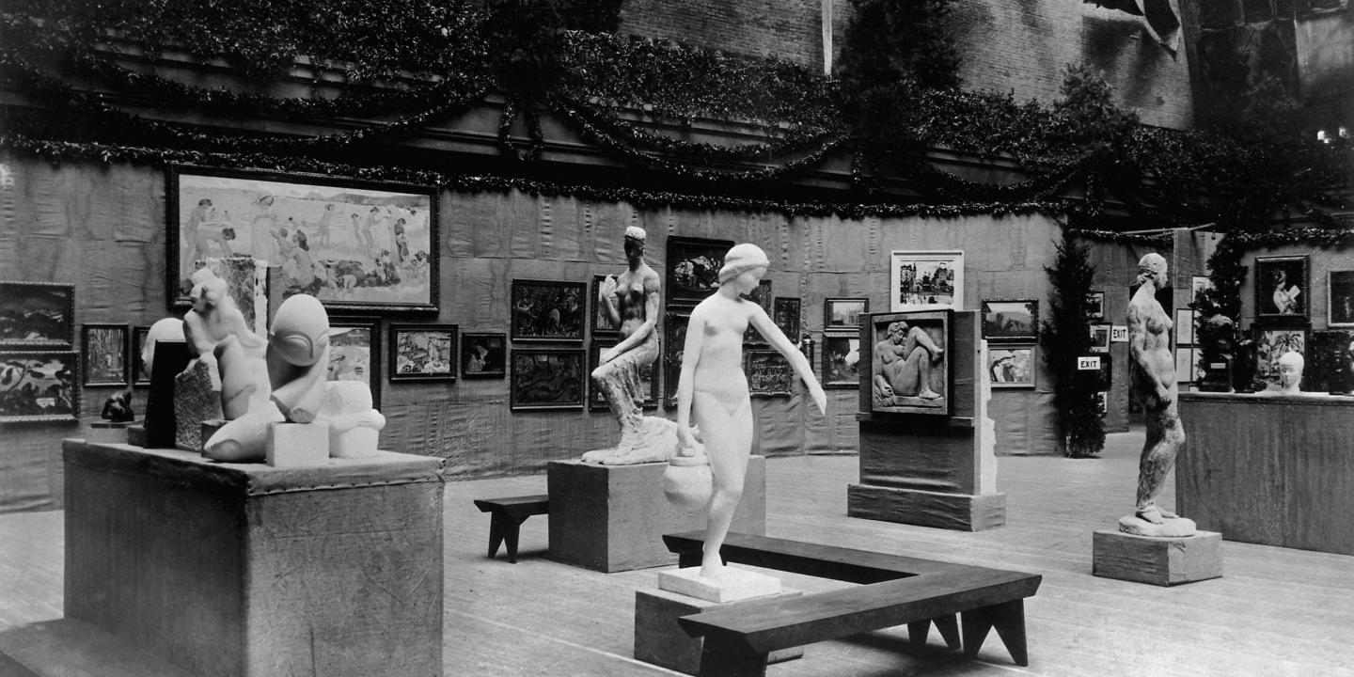
Armory Show
1913 - The first art show in the U.S., organized by the Ashcan School. Was most Americans first exposure to European Impressionist and Post-Impressionist art, and caused a modernist revolution in American art.
hen the Armory show opened in New York in 1913, it caused one of the biggest sensations the art world had ever known. An exhibition conceived by artists, it drew unprecedented crowds—about 87,000 at its debut in New York, 188,700 in Chicago, and 14,400 in Boston—publicizing modernism in a big way.

Slide 9
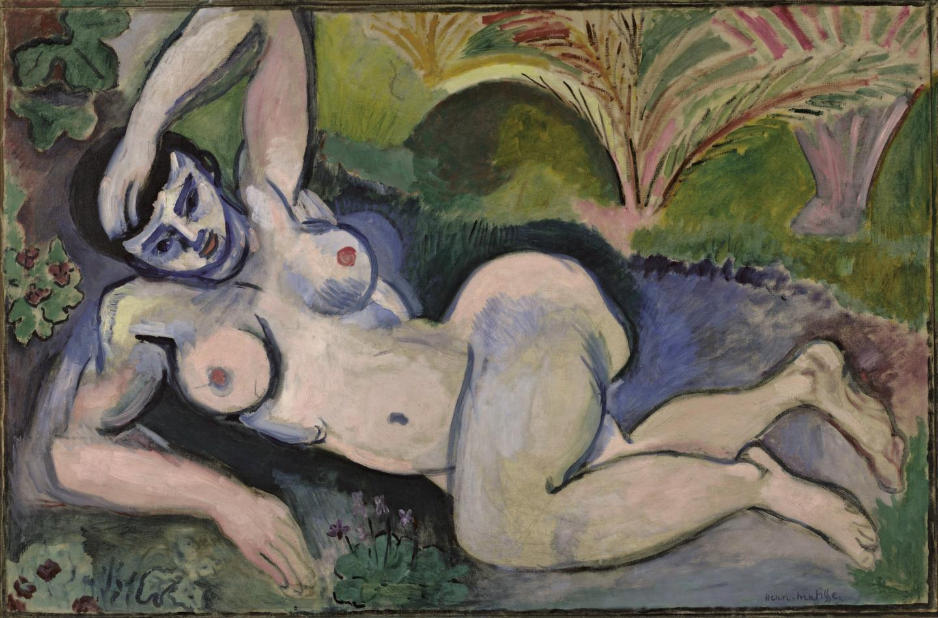
Armory show controversy
Two works in particular, Matisse’s Blue Nude and Duchamp’s Nude Descending a Staircase (No. 2), proved especially controversial to viewers in 1913 (and provided great fodder for satirical cartoons).
One art historian referred to Matisse’s work as “that toad”; Duchamp’s was famously explained as “an explosion in a shingle factory.”

Slide 10
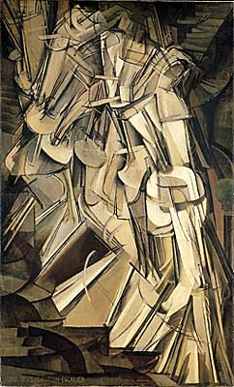
Marcel Duchamp
Marcel Duchamp (28 July 1887 – 2 October 1968; French pronunciation: was a French/American artist whose work is most often associated with the Dadaist and Surrealist movements. Duchamp's output influenced the development of post-World War I Western art.
Nude Descending a Staircase

Slide 11
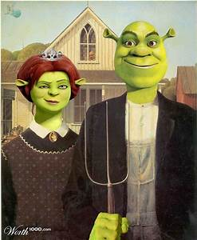
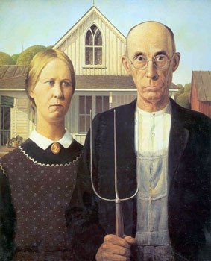
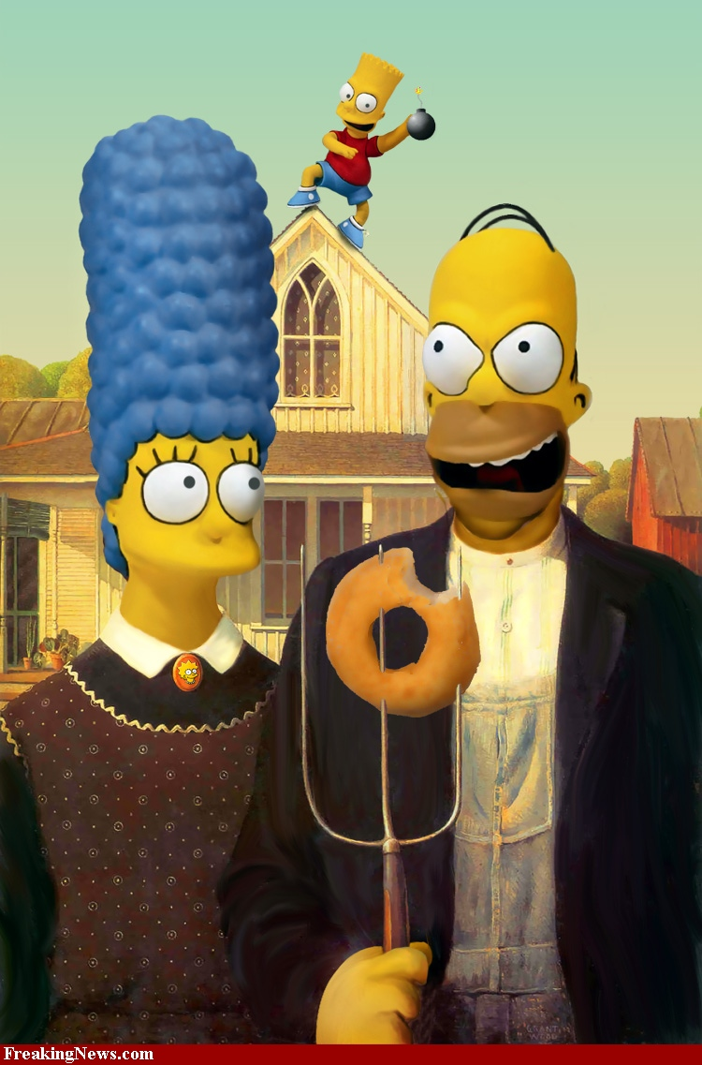
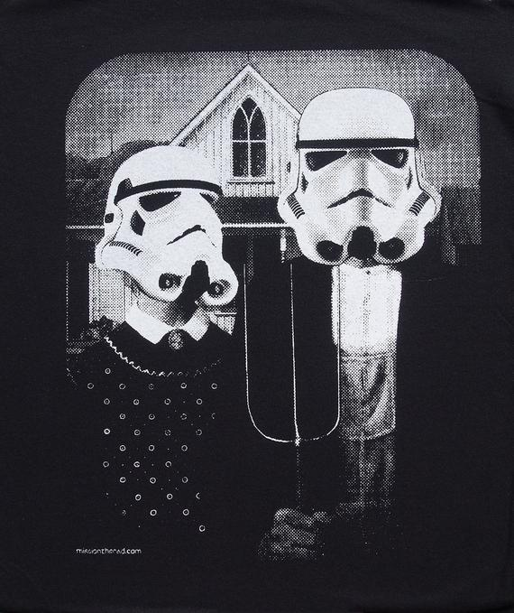
Grant Wood
Grant Wood was an American painter, born in Anamosa, Iowa. He is best known for his paintings depicting the rural American Midwest, particularly the painting American Gothic, an iconic image of the 20th century.
What is a parody?

Slide 12
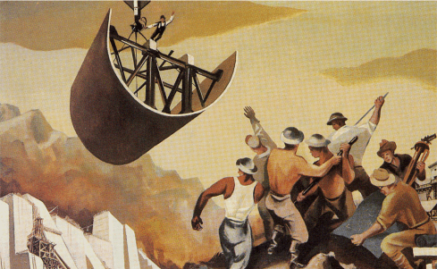
Construction of the Dam William Gropper
Cartoonist, Painter, Lithographs
Social Realist
Construction of the Dam shows the work during Roosevelt’s New Deal Programs.

Slide 13
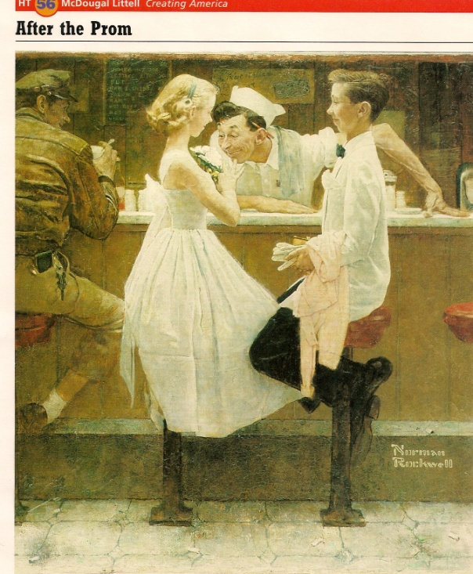
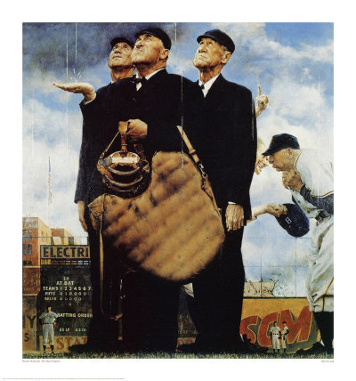
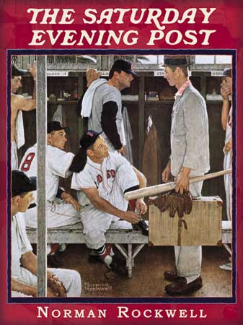
Norman Rockwell
Norman Rockwell (February 3, 1894 – November 8, 1978) was a 20th-century American painter and illustrator. His works enjoy a broad popular appeal in the United States, where Rockwell is most famous for the cover illustrations of everyday life scenarios he created for The Saturday Evening Post magazine over more than four decades.[

Slide 14
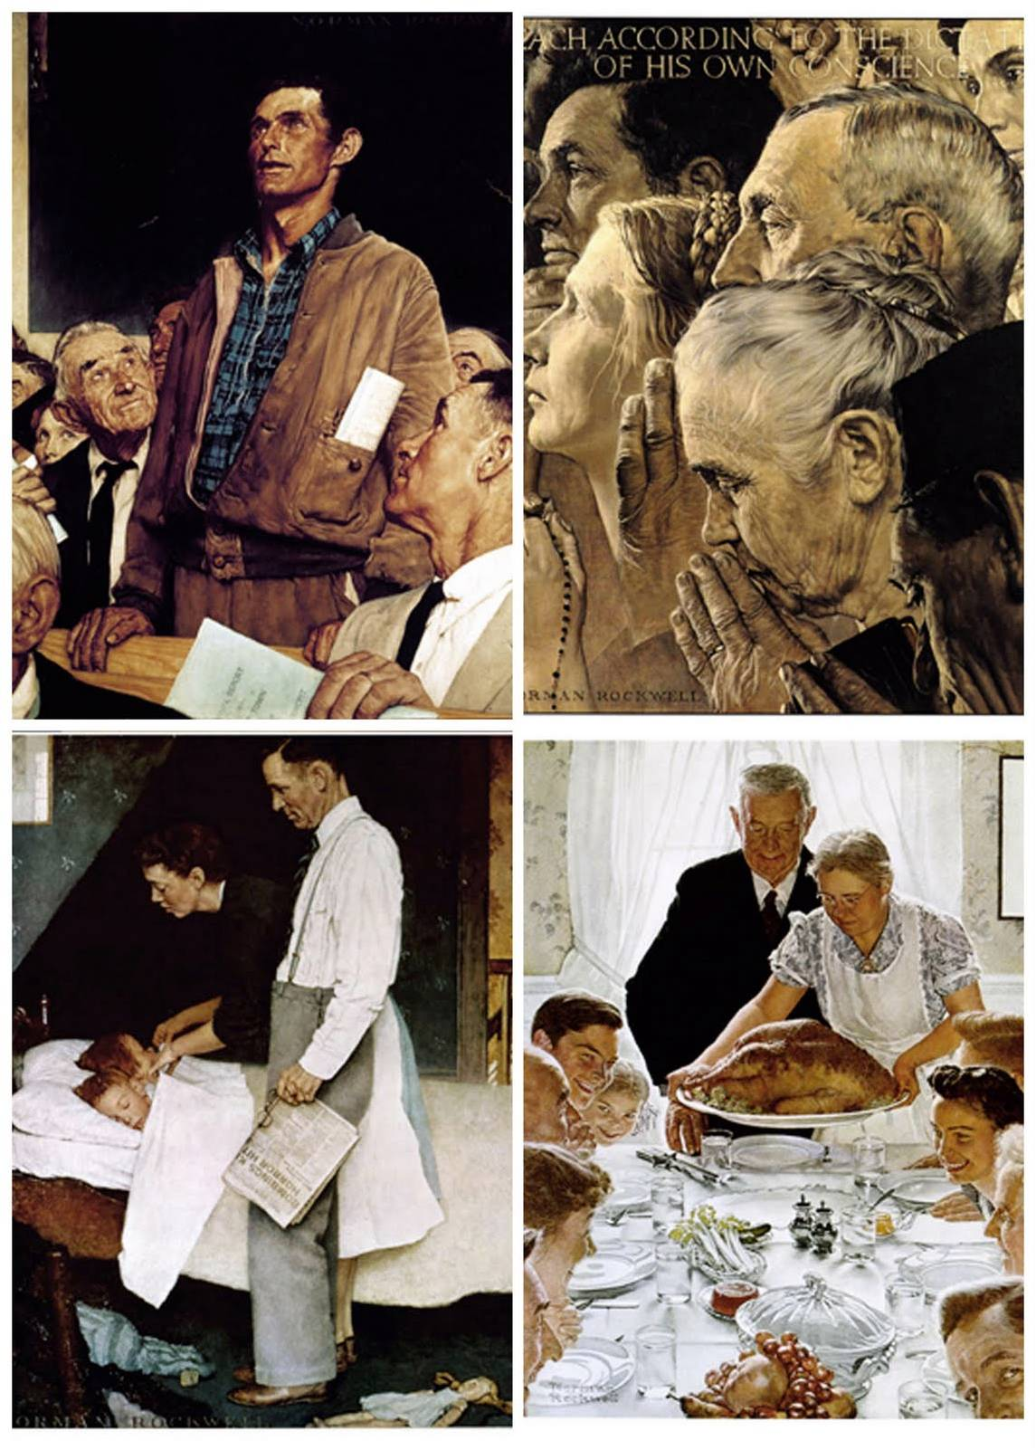
Four Freedoms: Norman Rockwell
January 1941 Four Freedoms State of the Union address in which he identified essential human rights that should be universally protected.
Based on a speech by Roosevelt the painting displays the four freedoms mentioned in the speech.
Freedom of Speech
Freedom of Religion
Freedom from Fear
Freedom from Want

Slide 15
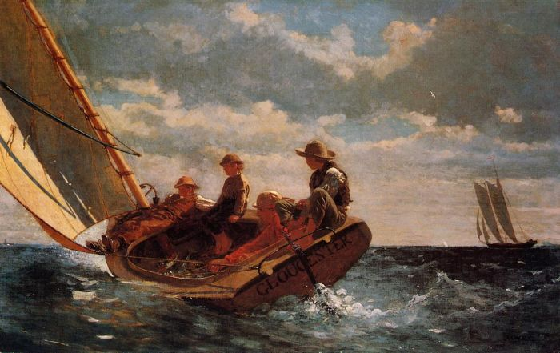
Winslow Homer
A Realist painter known for his seascapes of New England.

Slide 16
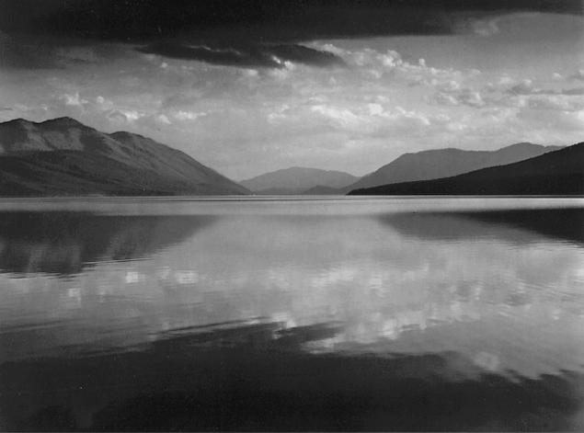
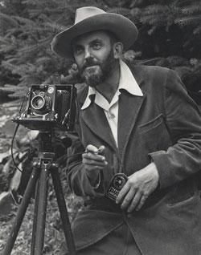
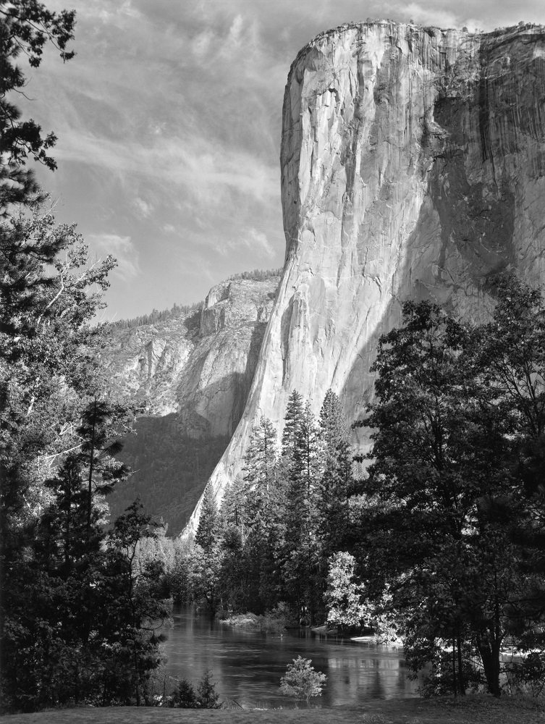
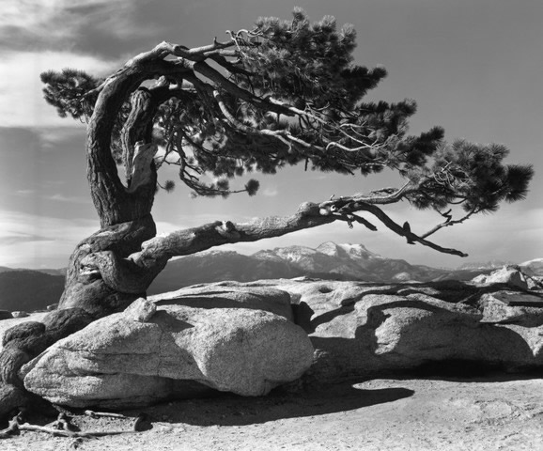
Ansel Easton Adams
Ansel Easton Adams (February 20, 1902 – April 22, 1984) was an American photographer and environmentalist, best known for his black-and-white photographs of the American West, especially in Yosemite National Park.

Slide 17
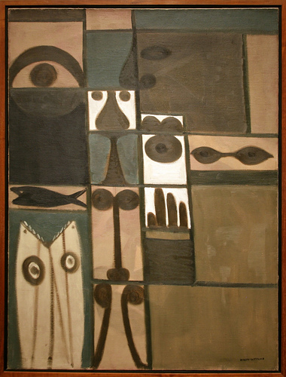
Adolph Gottlieb (March 14, 1903 - March 4, 1974) was an American abstract expressionist painter, sculptor and graphic art.
Adolph Gottlieb, one of the "first generation" of Abstract Expressionists, was born in New York in 1903 to Jewish parents.

Slide 18
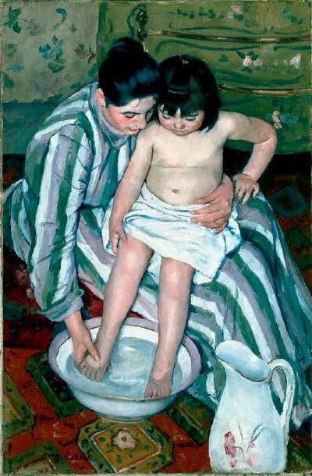
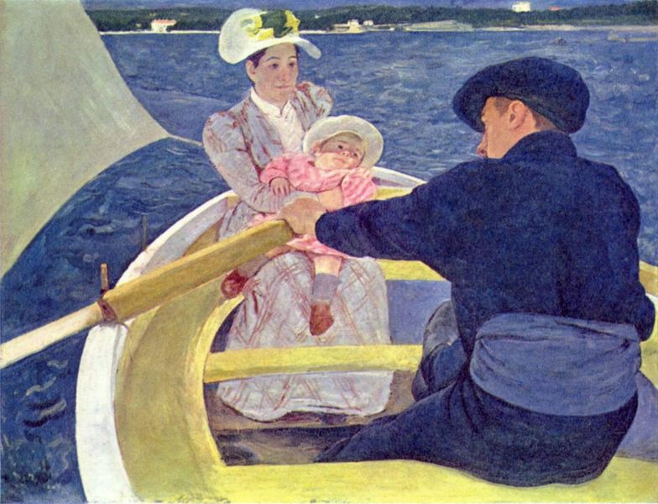
Mary Cassatt
Mary Stevenson Cassatt was an American painter and printmaker. She lived much of her adult life in France, where she first befriended Edgar Degas and later exhibited among the Impressionists.
Cassatt often created images of the social and private lives of women, with particular emphasis on the intimate bonds between mothers and children.

Slide 19
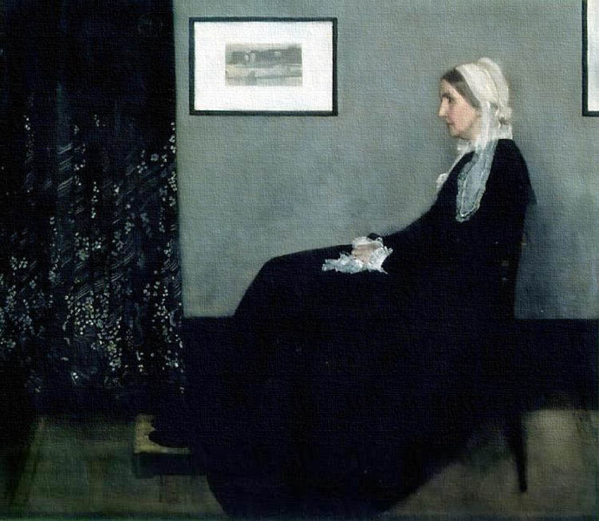
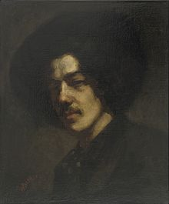
James Whistler
Arrangement in Grey and Black: The Artist's Mother, famous under its colloquial name Whistler's Mother, is an 1871 oil-on-canvas painting by American-born painter James McNeill Whistler

Slide 20
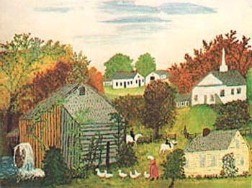
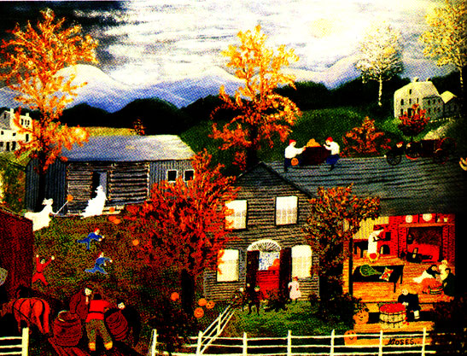
Grandma Moses
Anna Mary Robertson Moses (September 7, 1860 – December 13, 1961), better known as "Grandma Moses", was a renowned American folk artist. She is most often cited as an example of an individual successfully beginning a career in the arts at an advanced age. Moses had ten children but five died at birth.

Slide 21
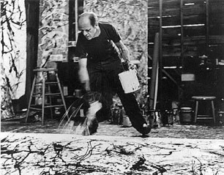
Jackson Pollock
Paul Jackson Pollock (January 28, 1912 – August 11, 1956) was an influential American painter and a major figure in the abstract expressionist movement. During his lifetime, Pollock enjoyed considerable fame and notoriety. He was regarded as a mostly reclusive artist.

Slide 22
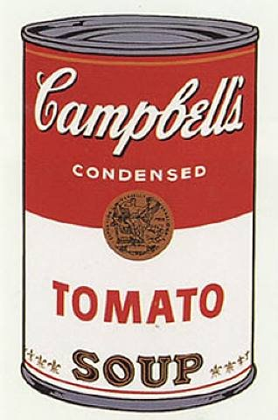
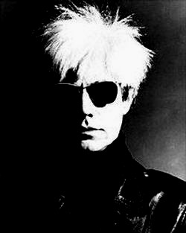
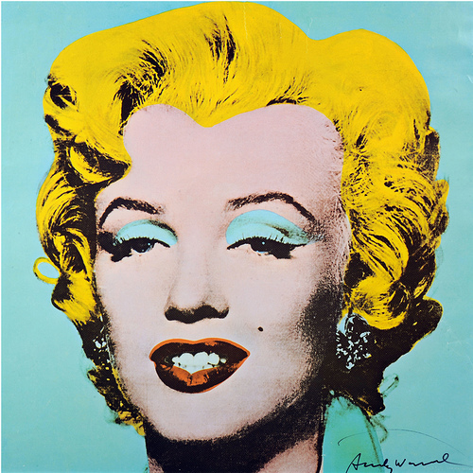
Andy Warhol
Andy Warhol was an American painter, printmaker, and filmmaker who was a leading figure in the visual art movement known as pop art.

Slide 23
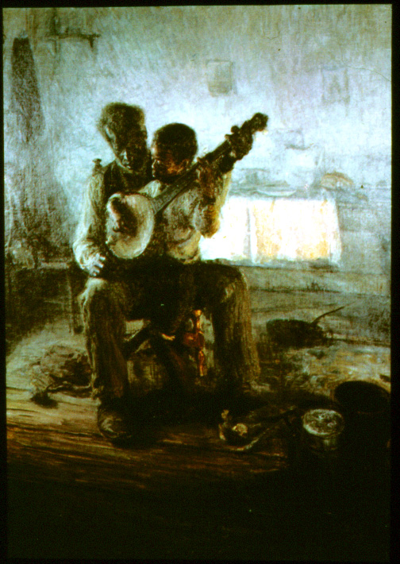
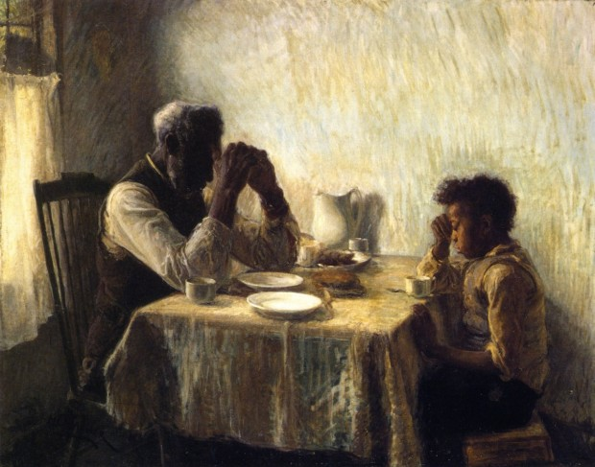
Henry Ossawa Tanner (June 21, 1859–May 25, 1937) was an African American artist best known for his style of painting. He was the first African American painter to gain international acclaim.
The Banjo Lesson
The Thankful Poor

Slide 24
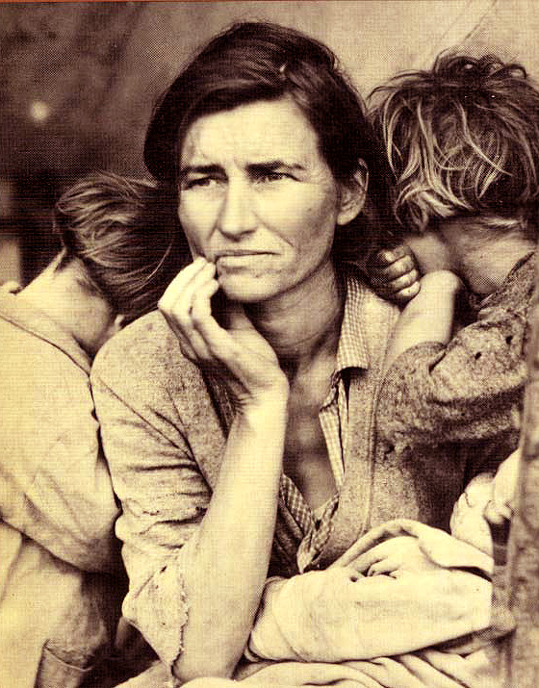
Dorothea Lange
Dorothea Lange was a famous female photographer in the 1930’s.
She took photographs of the suffering people during the Depression.
Lange’s photographs of the rural poor helped raise awareness about the poorest of the poor

Slide 25
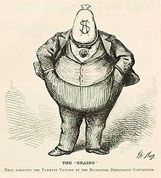
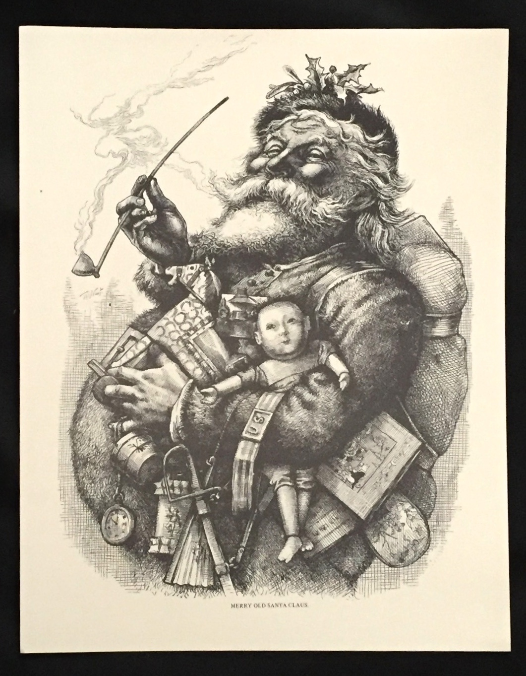
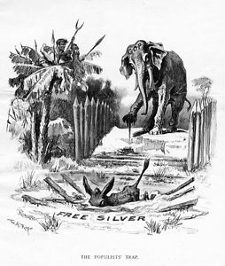
THOMAS NAST
Thomas Nast was an American political cartoonist that used caricatures in his drawings.
He is most well known for his attacks on Boss Tween using this format.
He is also known for assigning the Donkey and Elephant to the Democrats and Republicans.
At one point he was hired by Coca-Cola to depict Santa in the red and white Coca-Cola colors.

Slide 26
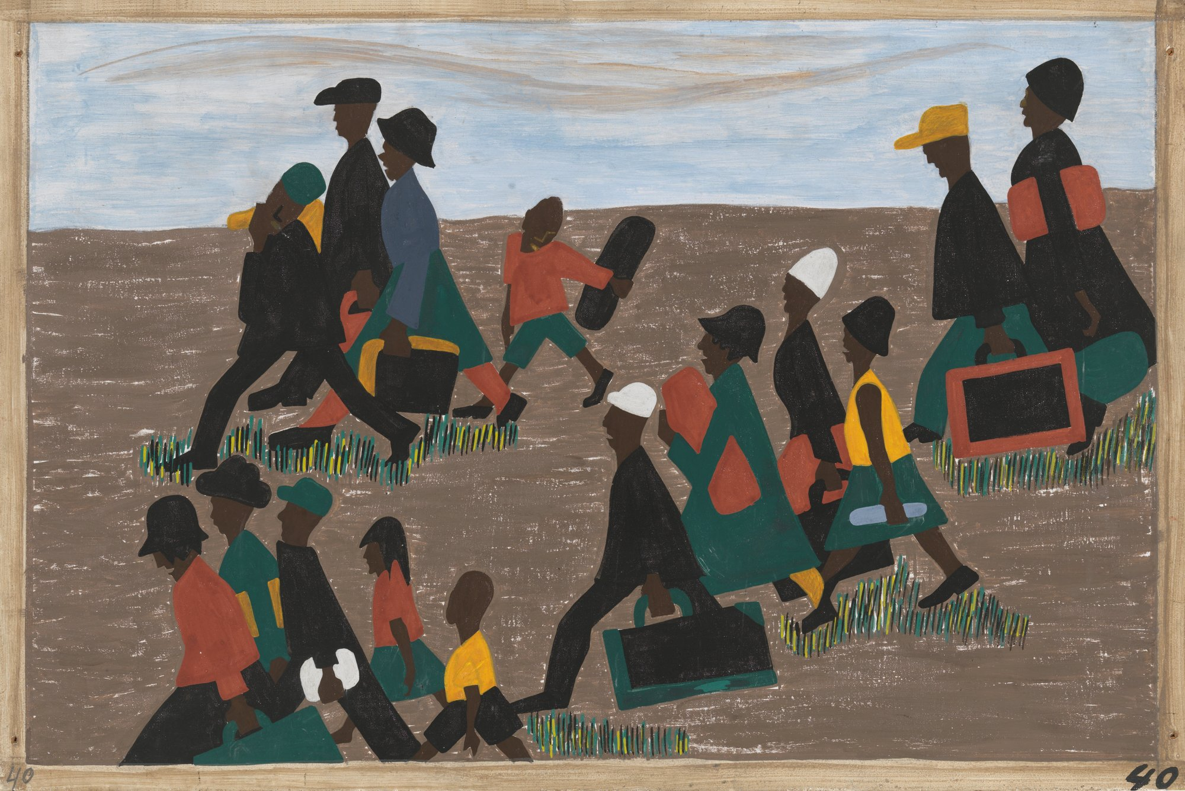
JACOB LAWRENCE
Lawrence is among the best-known 20th-century African-American painters. He was 25 years old when he gained national recognition with his 60-panel Migration Series, painted on cardboard. The series depicted the Great Migration of African-Americans from the rural South to the urban North.

